Slide 1
Final Proposal
Cathy Xu

Slide 2
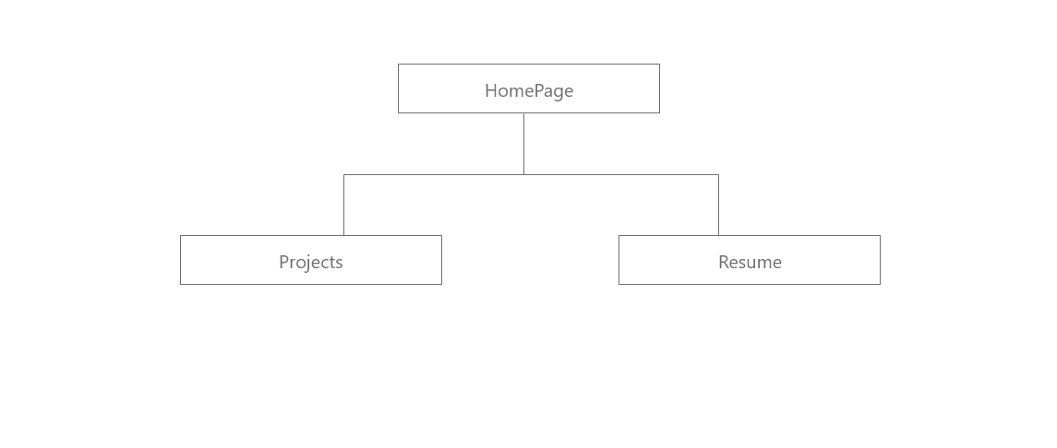
Sitemap

Slide 3
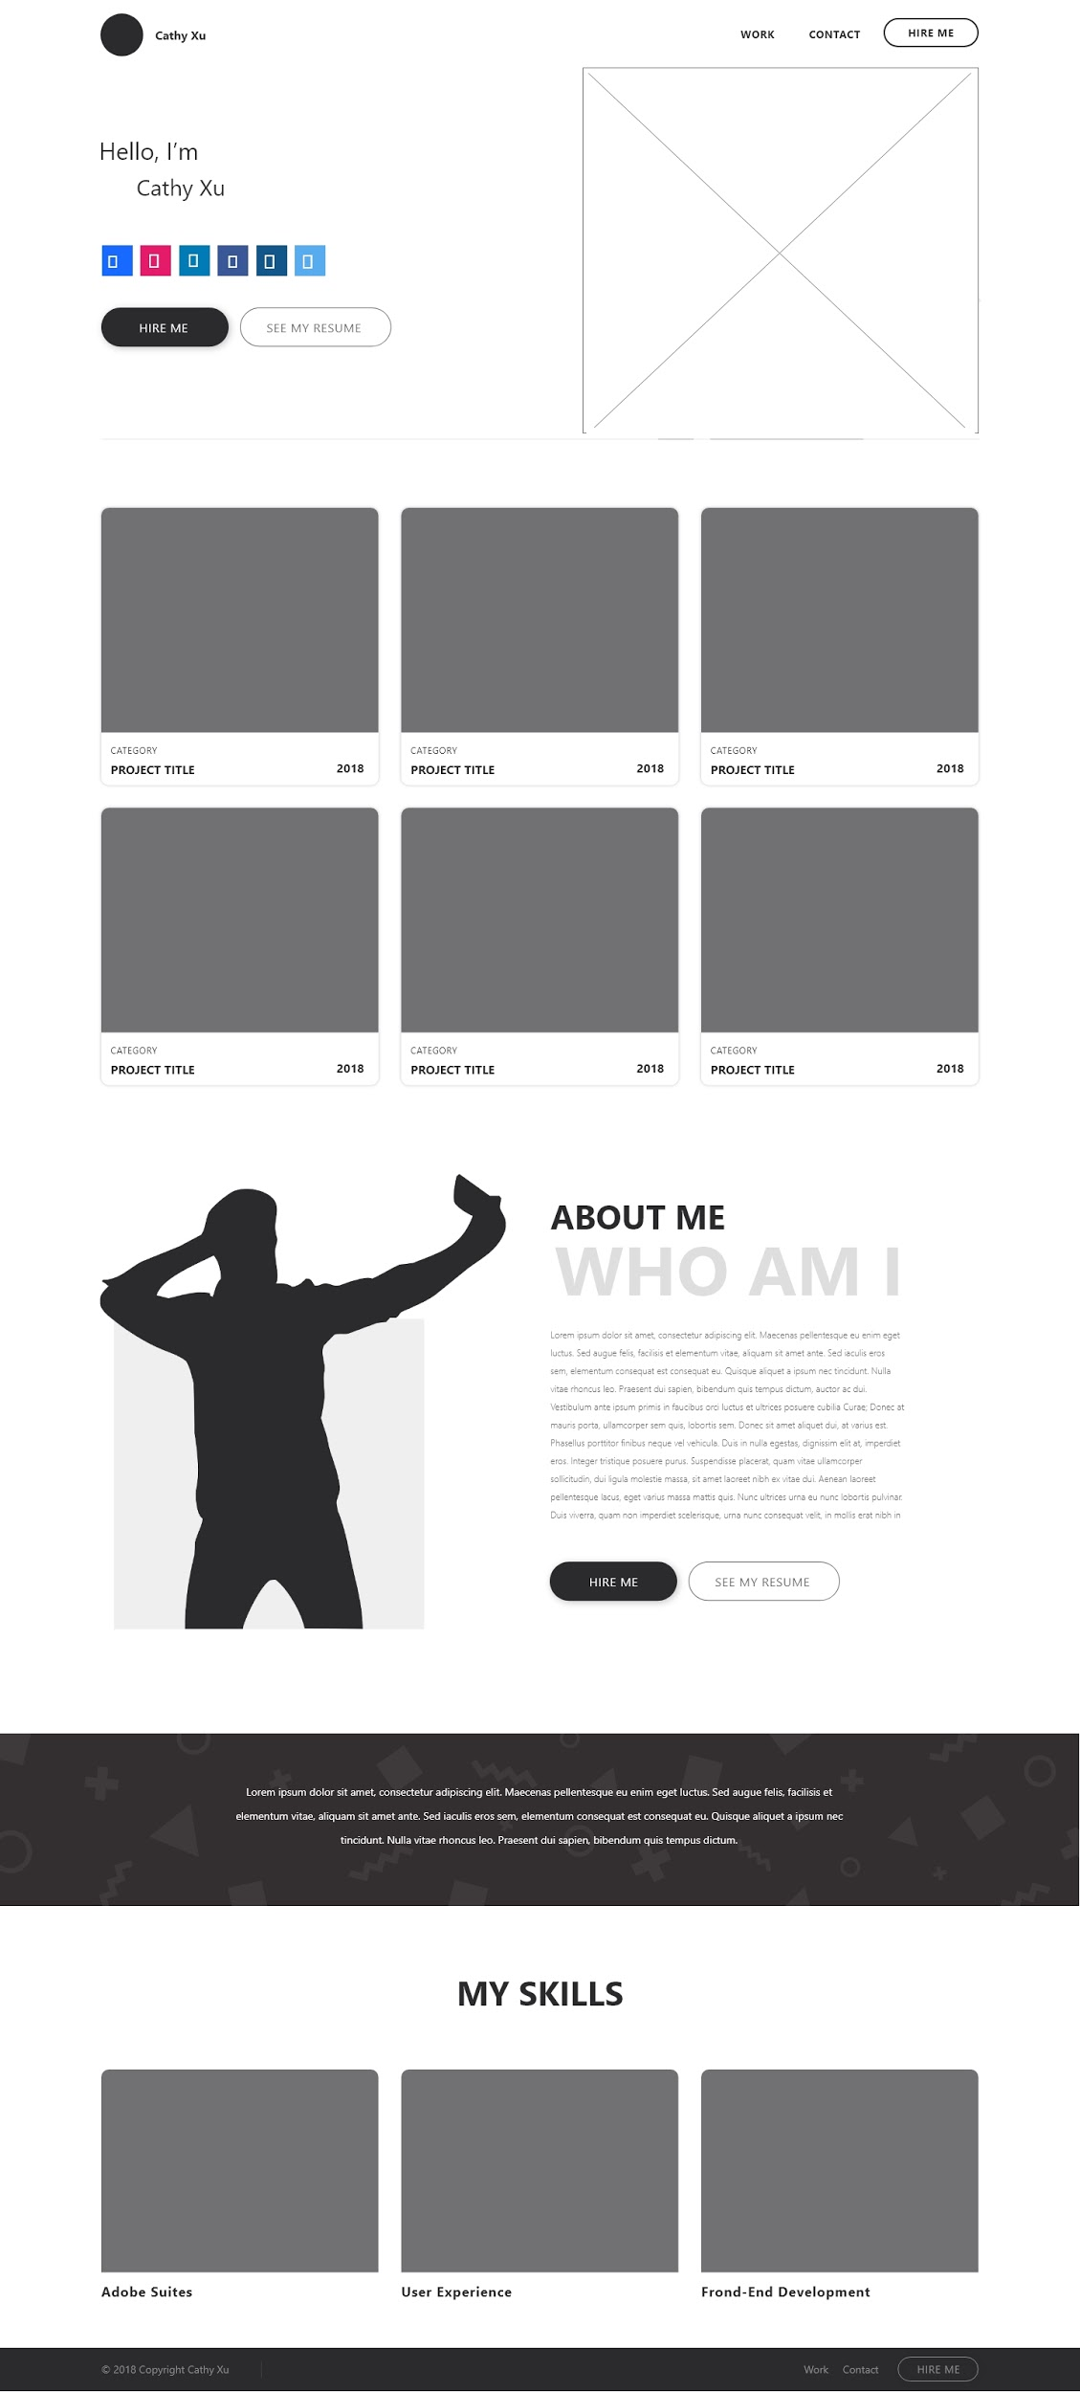
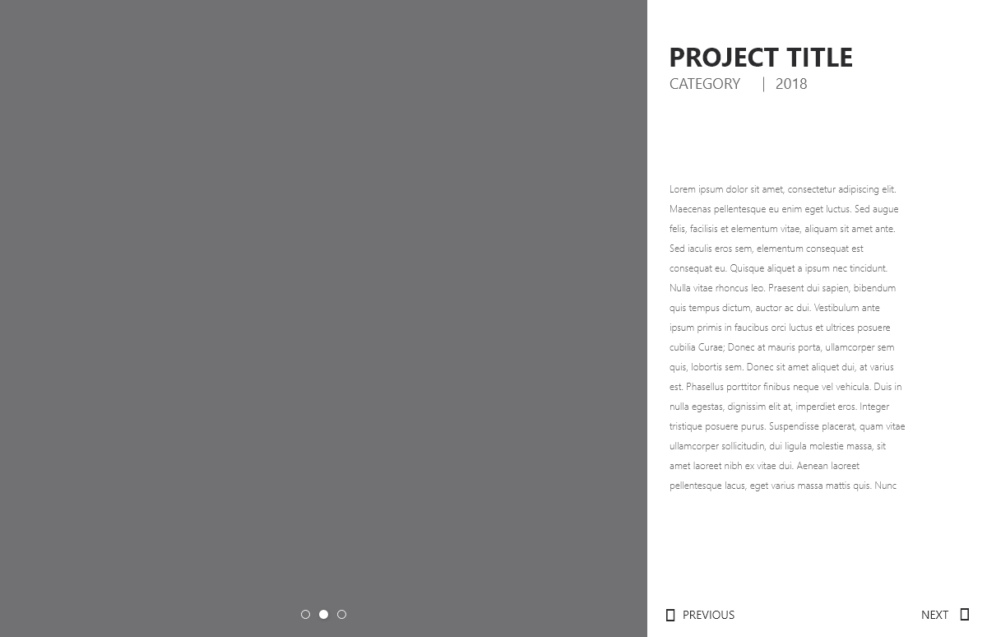
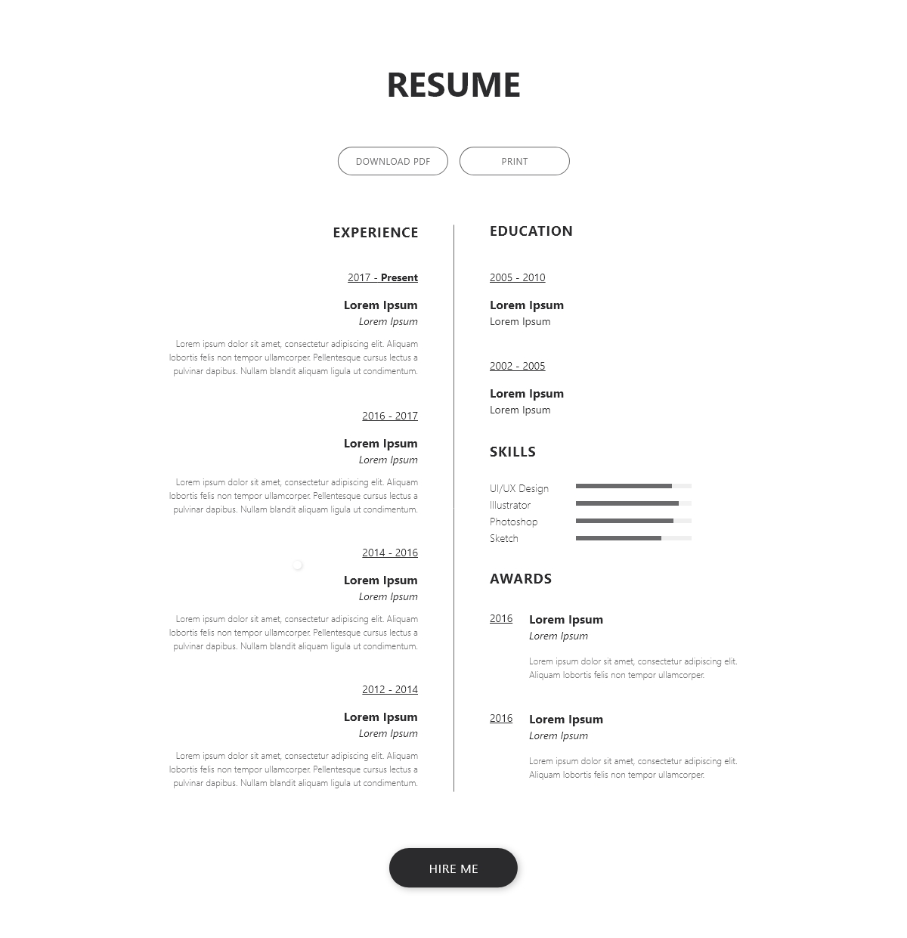
Wireframe

Slide 4


Inspirations

Slide 5
Concepts
Redesign
Bootstrap
Animated Title (JS)

